Slide 1
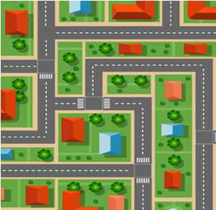

Slide 2
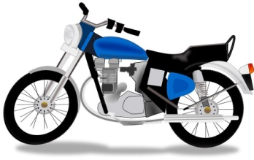
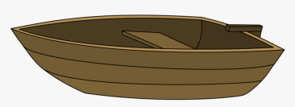
R/r
R/r
R/r
R/r
R/r
R/r
R/r
R/r
R/r
R/r
R/r
R/r
R/r
R/r

Slide 3
MAPA MODELO
R/r
R/r
R/r
R/r

